Slide 1
Momentum and Rotation
Get it bc I used the theme that has circles and rotational things go in circles just like my brain after I saw the AP Physics C Mech exam

Slide 2
Bruh Momentum

Slide 3
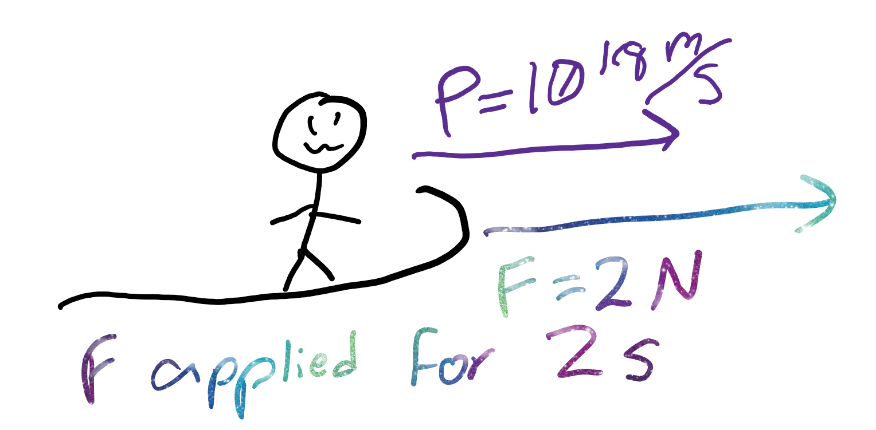
Impulse
Impulse is change in momentum
Mostly, just remember F * t is change in momentum because F = p/t

Slide 4
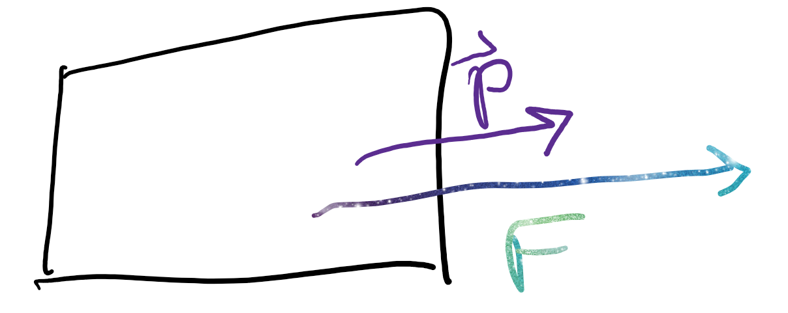
Force - Momentum what?
Pushing something changes speed, so force affects momentum
F = m*a
a = v/t
F = m*v/t = (m*v)/t = p/t

Slide 5
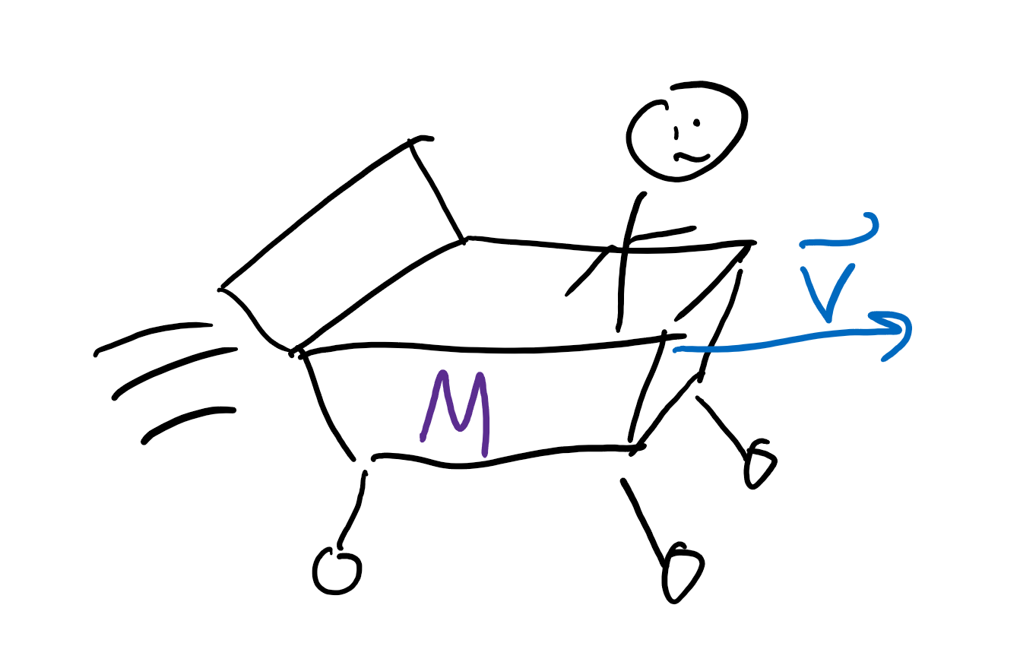
Shopping cart go whee
Newton’s First law says things that have mass go whee
In science terms: velocity is constant for a given mass if no other force is applied
Momentum (p) = m * v
https://www.youtube.com/watch?v=al20AFLf4n8

Slide 6
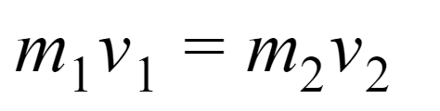
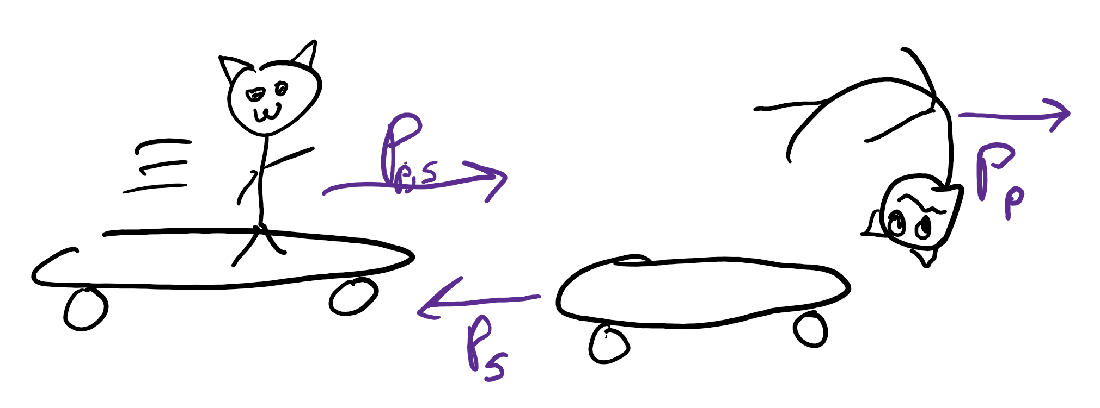
Conservation of momentum? Pog?
By Newton’s second law, momentum is conserved if no other force is applied.

Slide 7
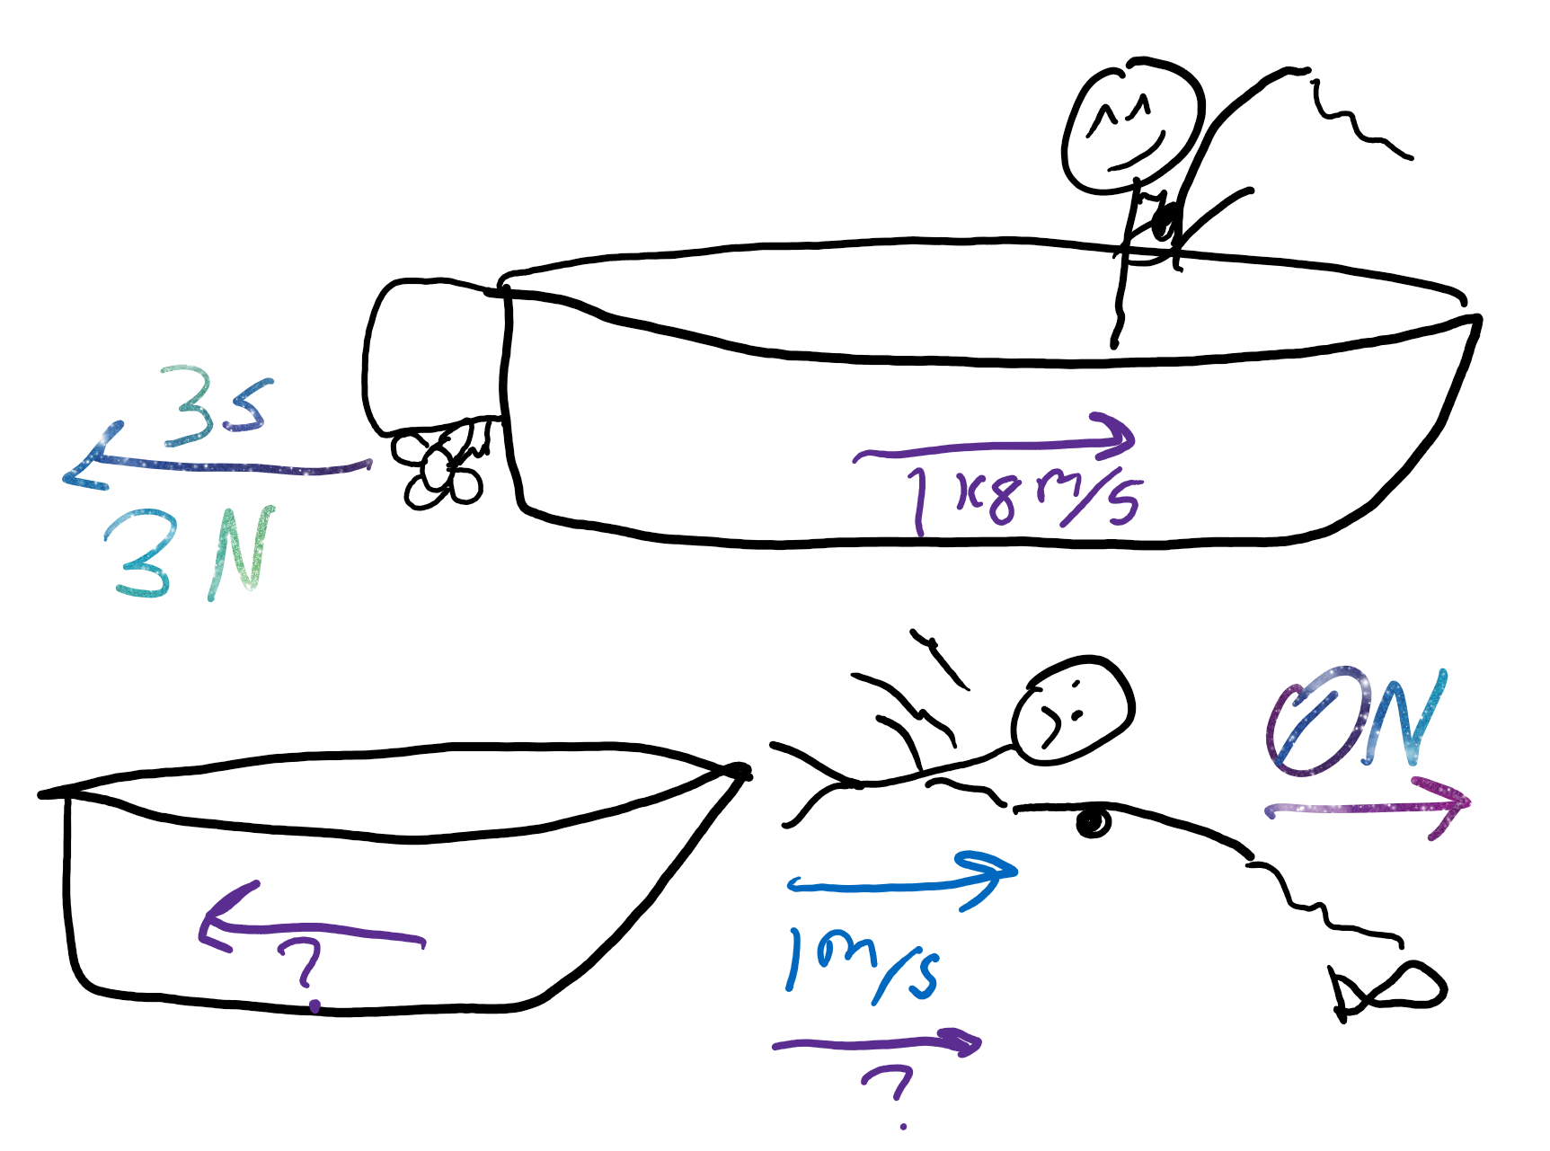
Review
A motor applies a force of 3 N for 3 seconds to a boat with initial momentum 1 kg m/s. What is the new momentum?
If a 1 kg person jumps off the boat at 1 m/s, what momentum does he have?
What is the new momentum of a boat?

Slide 8
Rotational measurements

Slide 9
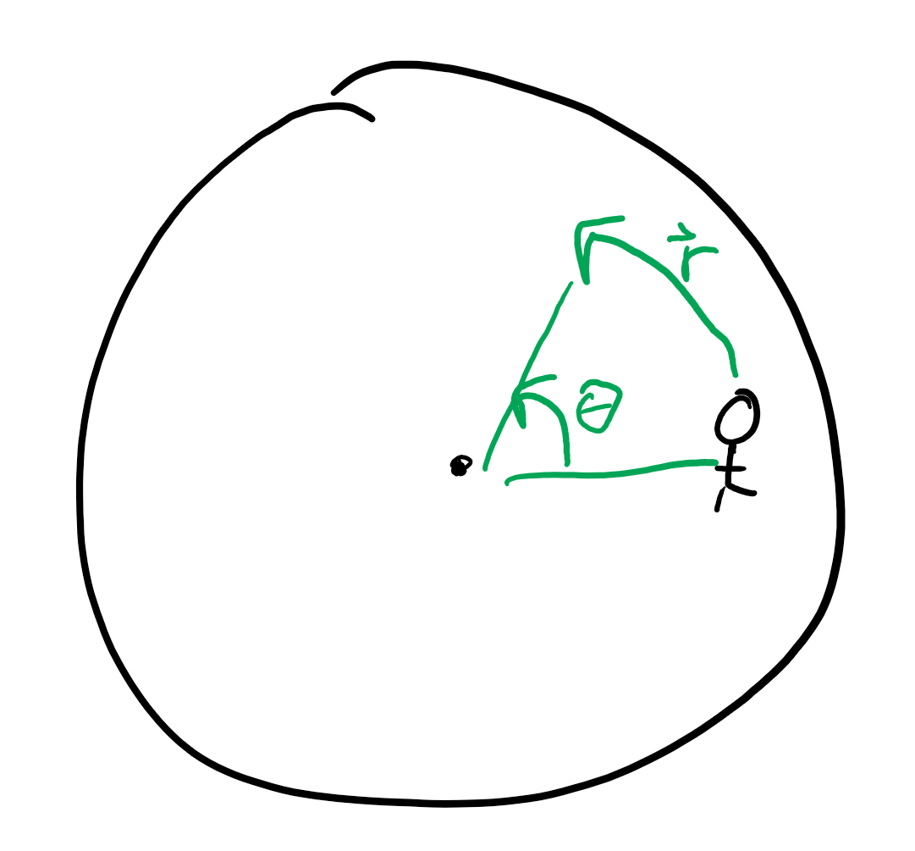
Angular distance
How many degrees/radians you rotated
Unitless
Usually measured in radians (a number out of 2pi)

Slide 10
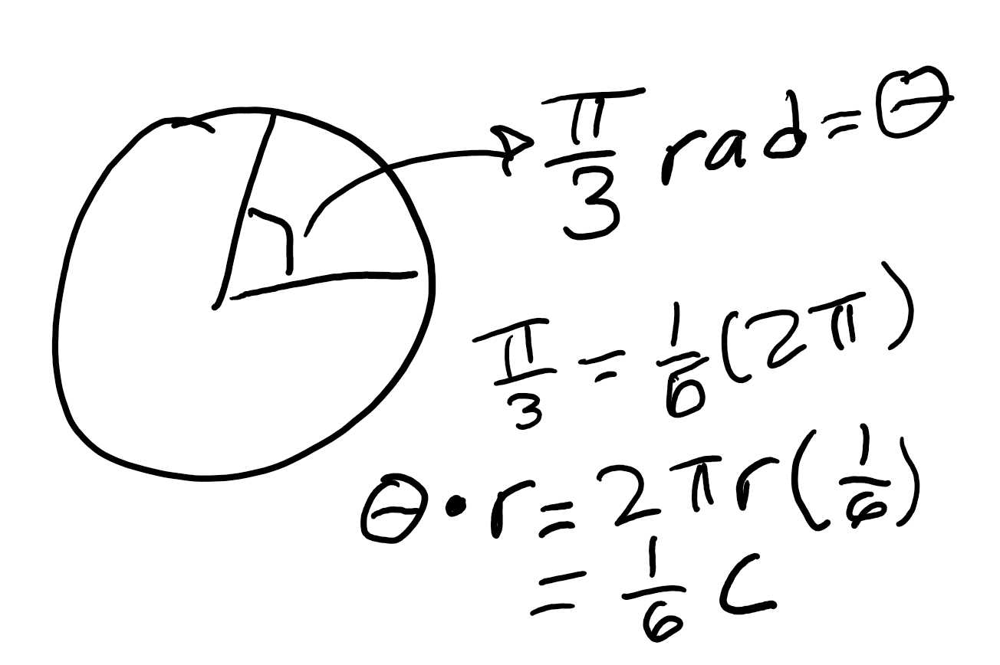
Distance vs angular distance
Circumference is?
Radians are?
Radius times radians is?
Radius * 2 pi
Some fraction of 2 pi
The fraction of the circumference we traveled on (a distance!)

Slide 11
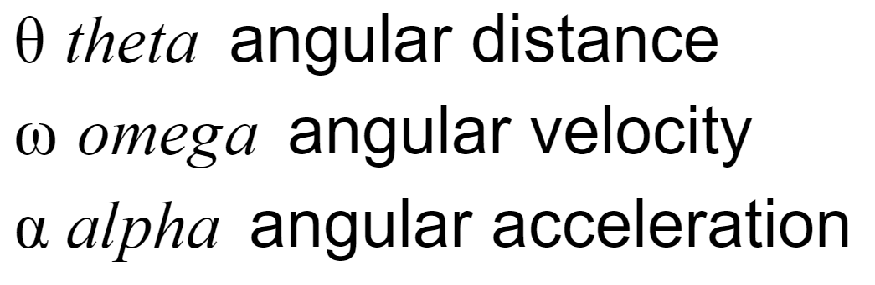
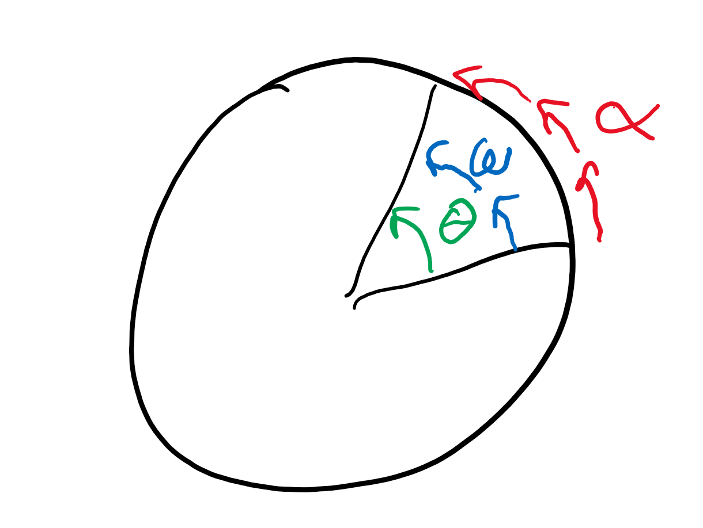
Other angular measures
Any angular measure multiplied by the radius of the rotation gives the linear analog (aka, distance, velocity, acceleration)

Slide 12
Quick rev
If I travel 2 meters along a circle with a radius of 1 m, what is my angular distance?
If I move at an angular acceleration of 25 rad/s^2 on a circle with a radius of .1 m, what is my linear acceleration?

Slide 13
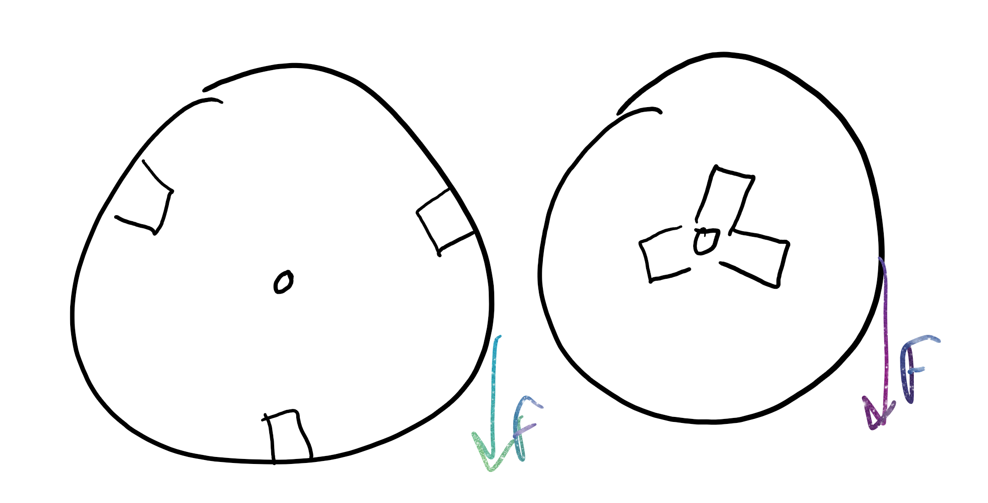
Moment of Inertia
What is inertia?
Moment of inertia is inertia, but for rotating objects; aka, it opposes spinning for objects not spinning and opposes stopping for spinning objects.

Slide 14
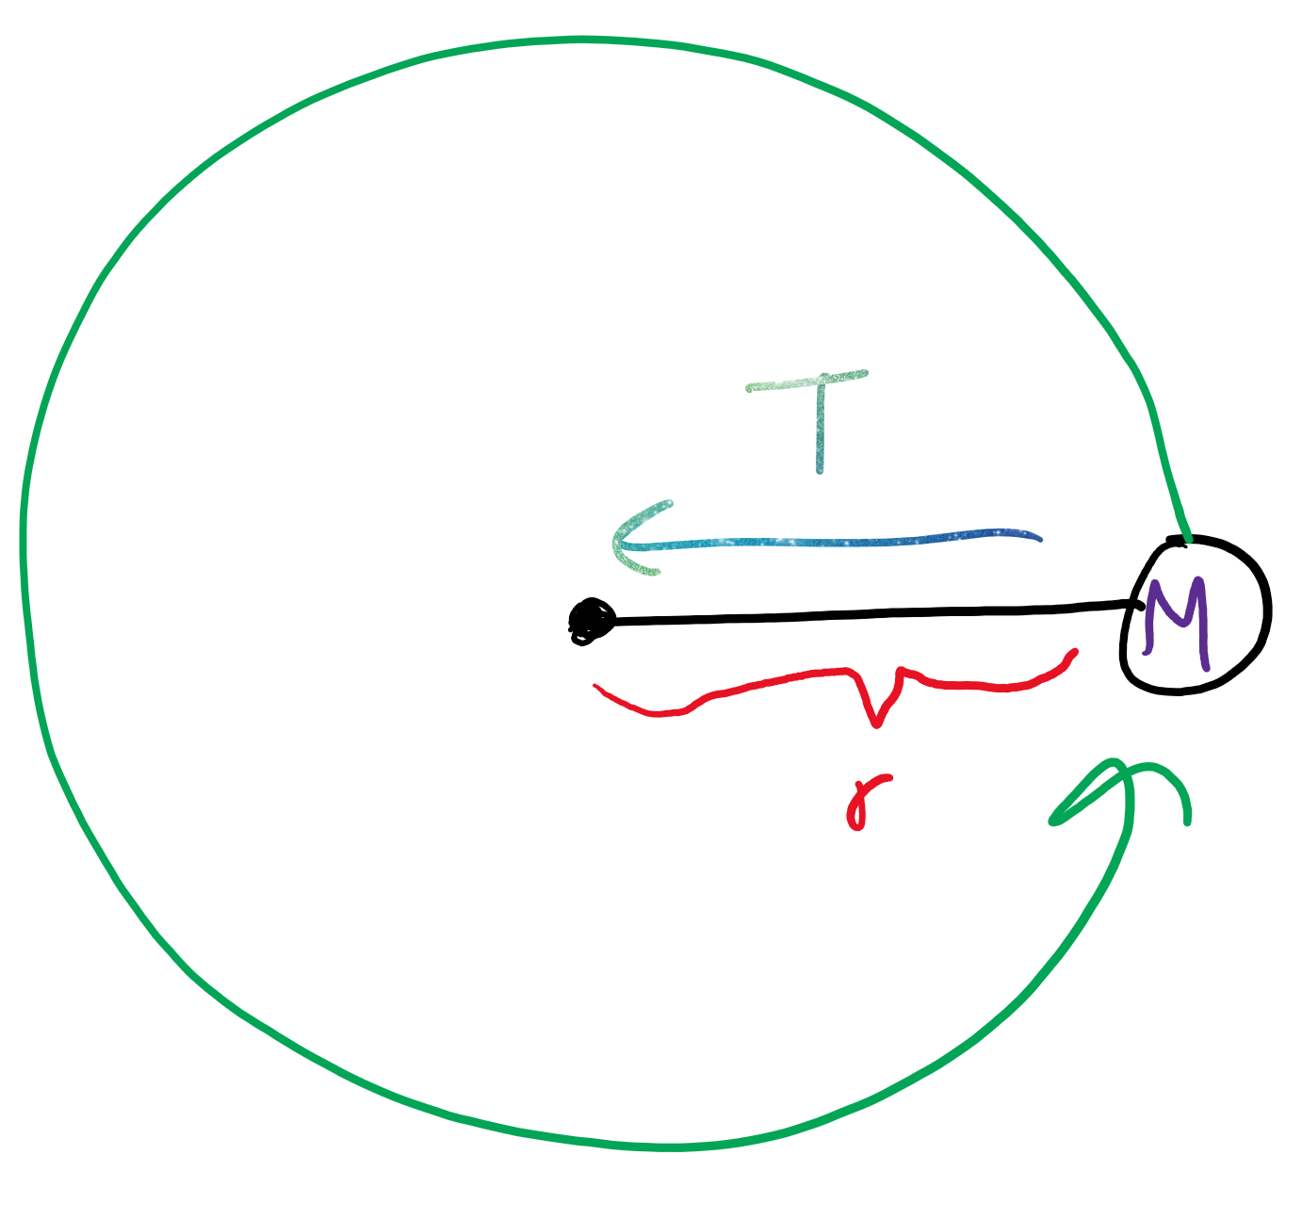
“Equation”
I = mr^2
Harder to spin more massive things; the further the mass is, the harder it is to rotate.

Slide 15
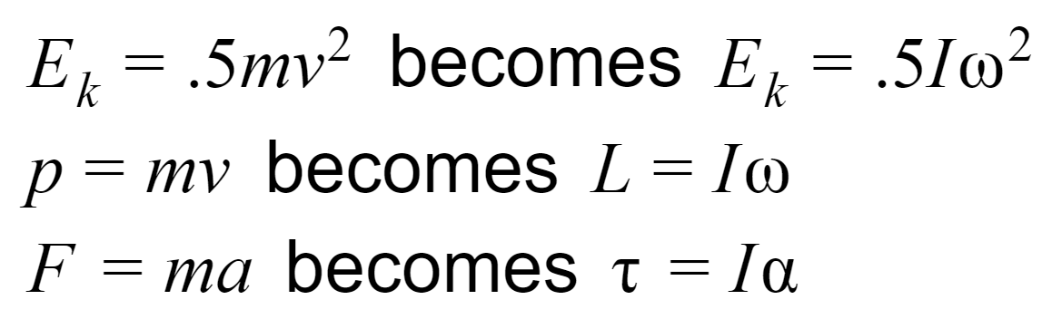
Rotational analogs of everything
In order: Linear kinetic energy -> Rotational kinetic energy Linear momentum -> Angular momentum Force -> Torque

Slide 16
Torque

Slide 17
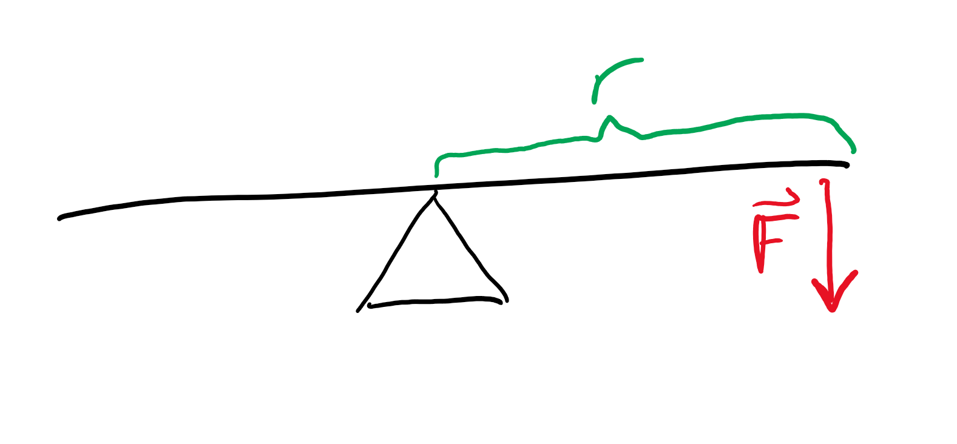
On a lever
Torque is “spinny” force
Is it harder or easier to push on a longer lever?
Does the thing spin faster or slower with more force applied?

Slide 18
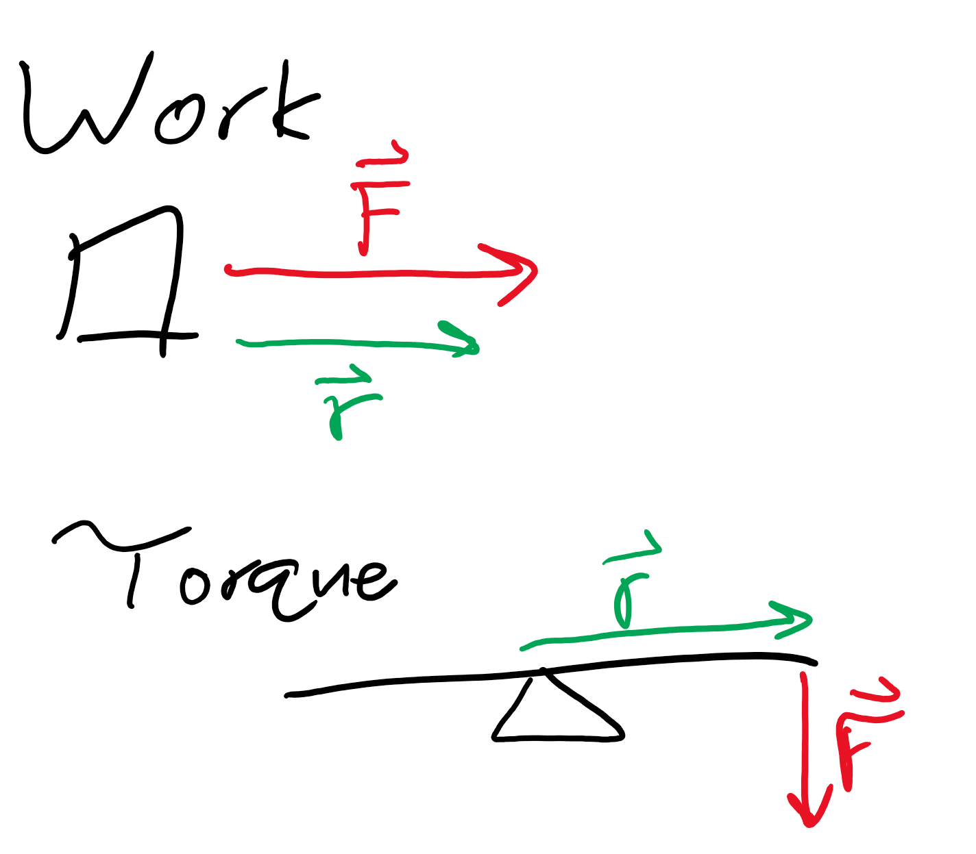
Work vs Torque
Both are force times distance.
With work, the force is in the direction of the distance traveled
With torque, force is perpendicular to the distance (lever arm)
Work is N * m (Joules)
Torque is m * N (not Joules)

Slide 19
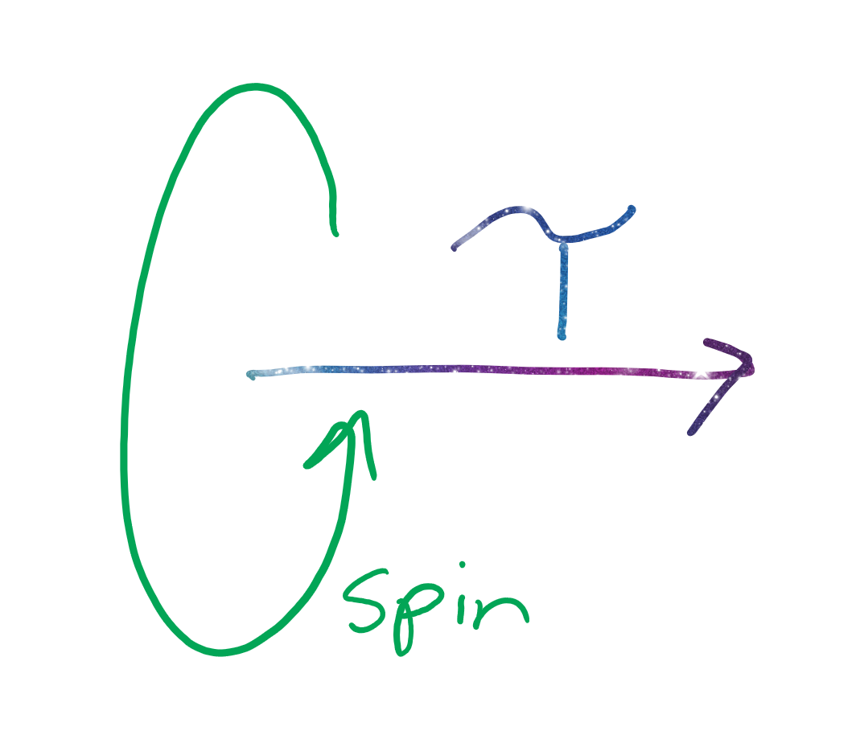
How Torque is represented
Perpendicular to the plane of motion
Let’s say an object is spinning counterclockwise. Take your right hand and make a thumbs up, so the “curl” of your fingers follows the direction of the spin. Your thumb points to the direction of torque.

Slide 20
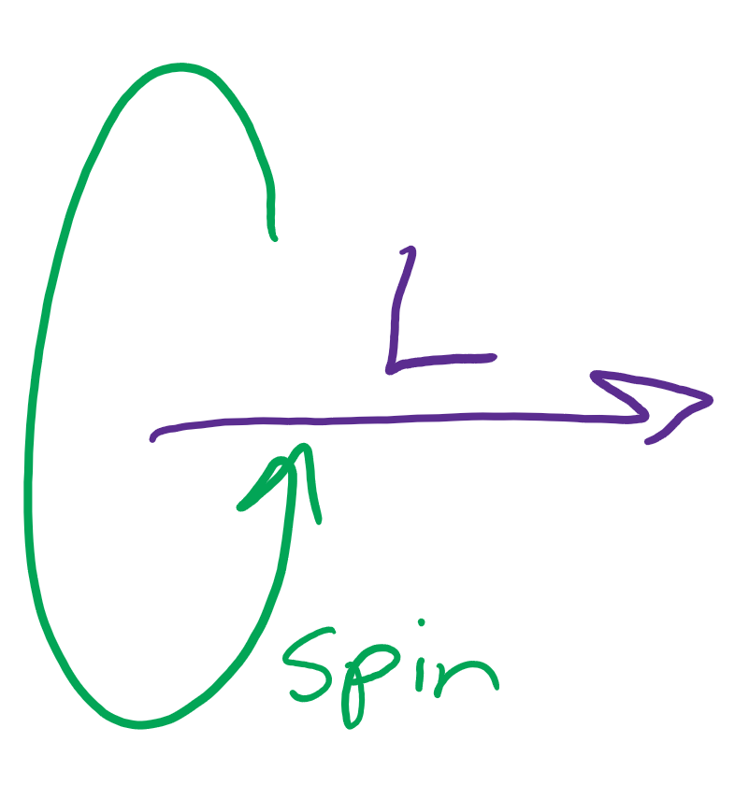
Angular momentum representation
Similar to torque, but the magnitude is moment of inertia * angular velocity

Slide 21
Gyroscopic rotation

Slide 22
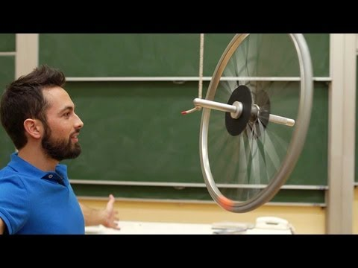
Gyroscopic precession
https://www.youtube.com/watch?v=ty9QSiVC2g0

Slide 23
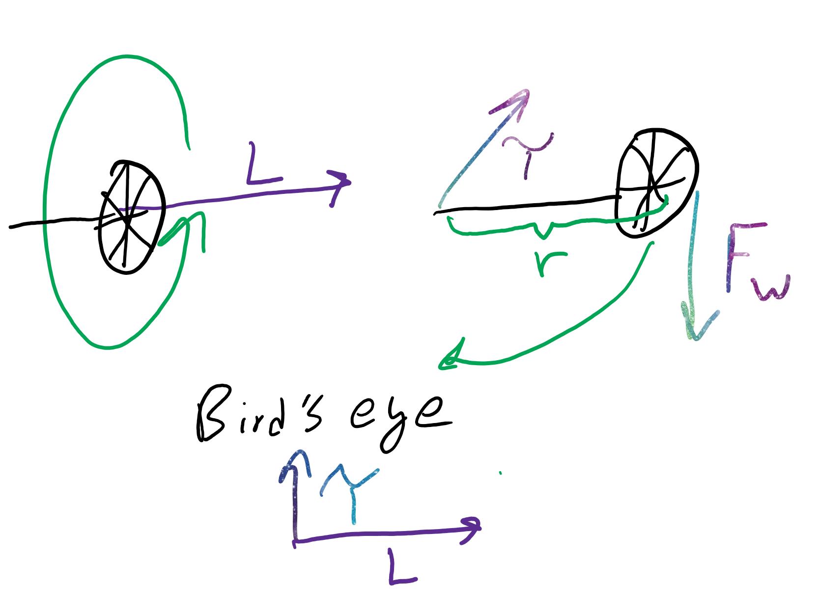
The frick is going on?
Top left: we have angular momentum because the wheel has angular velocity.
Top right: we have torque because weight (force) pulls on a lever (the thing labeled r)
Bottom: putting the two things together

Slide 24
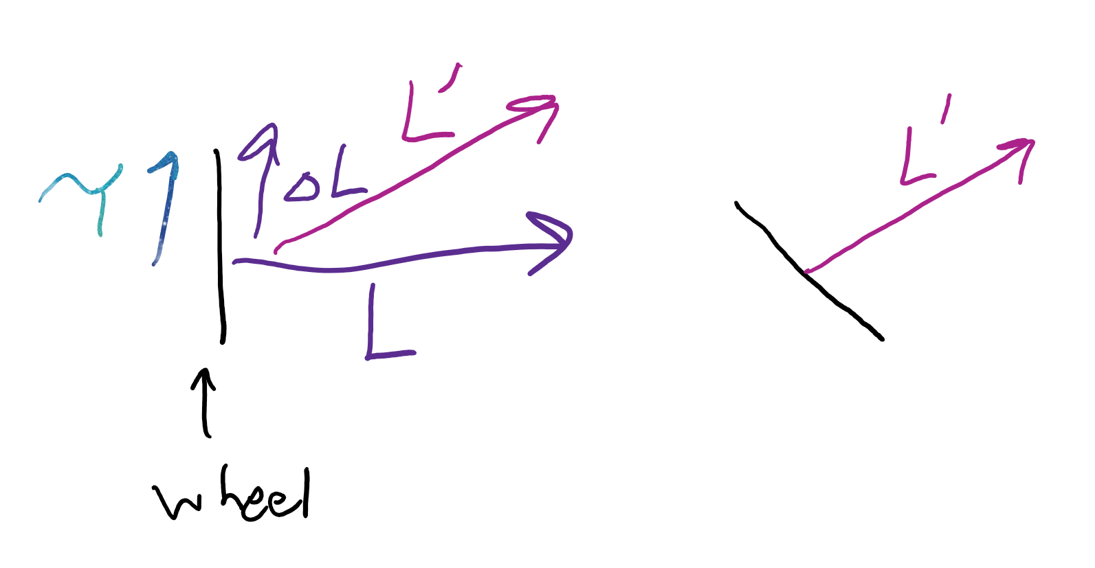
Continued
Left: torque is change in angular momentum over time. . . so the new momentum (denoted L’) points a little upward from what it started as
Right: if the wheel turns that way, by the right hand rule, our angular momentum matches L’

Slide 25
Review get baited we’re doing review I’m so tired

Slide 26
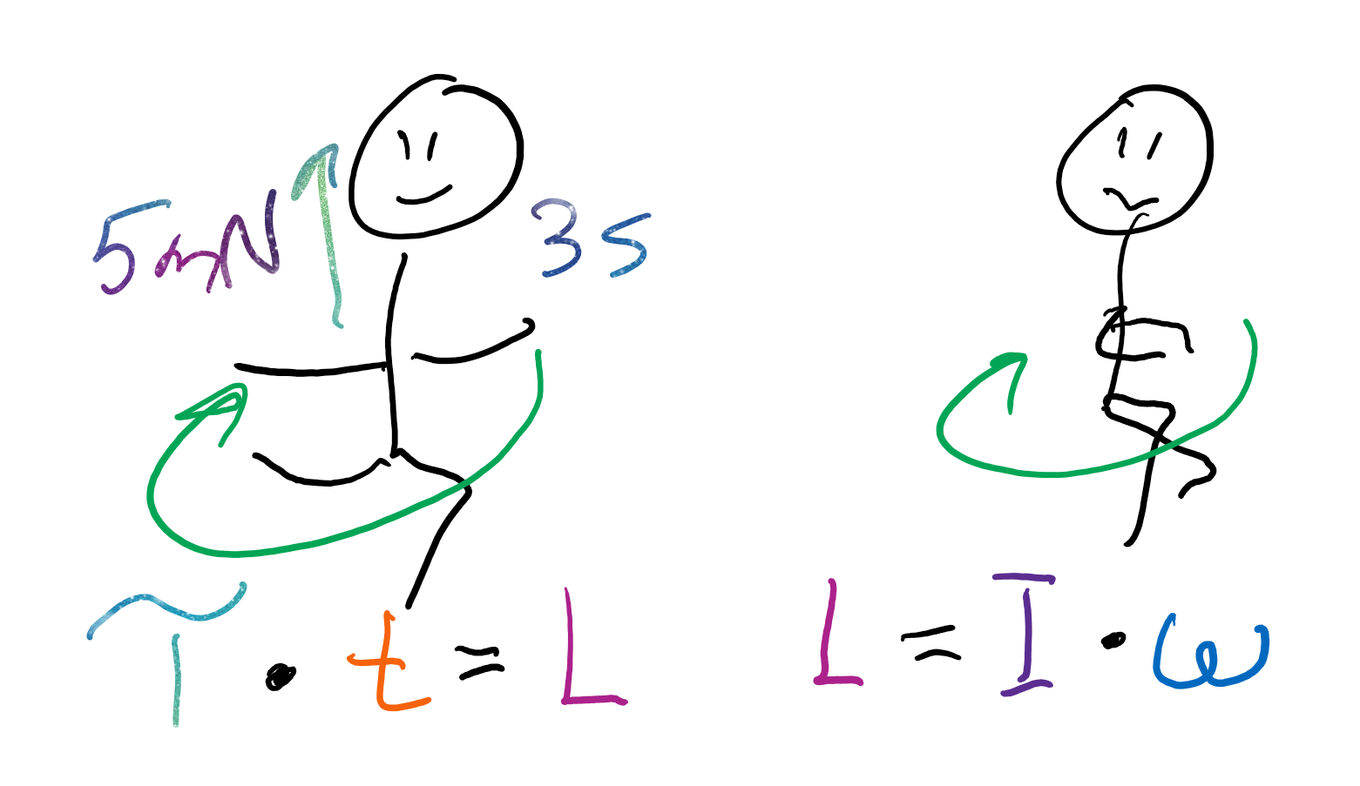
Angular momentum samples
I apply a torque of 5 mN to a my 4 kg m^2 moment of inertia body for 3 seconds. What is my angular momentum?
If I change my moment of inertia to 3 kg m^2, what is my new angular velocity?

